Slide 1
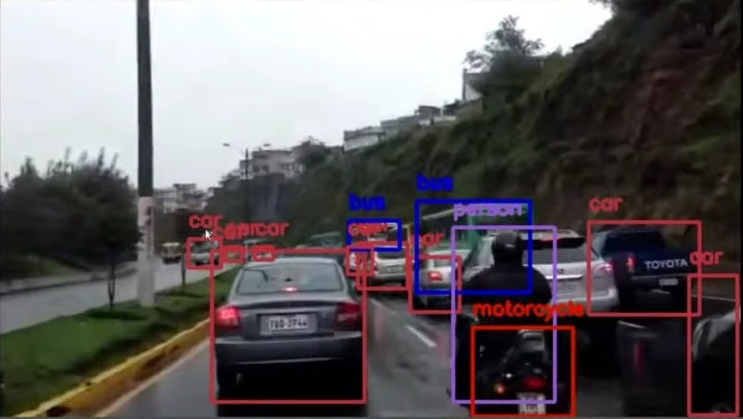
Real Time Object Detection
Notes:
‹#›

Slide 2
Contents
Introduction
Objectives
Scope
Features / Functionality
Project Outcomes
Technology Stack
Block Diagram
Notes:
‹#›

Slide 3
1. Introduction
Object detection is a technology that detects the semantic objects of a class in digital images and videos. One of its real-time applications is self -driving cars.
In this, our task is to detect multiple objects from an image. The most common object to detect in this application is the car, motorcycle, and pedestrian and other objects in a roadway.
For locating the objects in the image we use Object Localization and have to locate more than one object in real-time systems.
Notes:
‹#›

Slide 4
1. Introduction
There are various techniques for object detection, they can be split up into two categories, first is the algorithms based on Classifications. CNN and RNN come under this category.
The second category is the algorithms based on Regressions. The YOLO method comes under this category.
The YOLO algorithm is fast as compared to other classification algorithms.
Notes:
‹#›

Slide 5
2. Objectives
The main purpose of object detection is to identify and locate one or more effective targets from still image or video data. It comprehensively includes a variety of important techniques, such as image processing, pattern recognition, artificial intelligence and machine learning.
To automate the recognition and extraction process.
To detect the object segment from the video frame.
To classify the features in order to recognize the objects detected.
To provide efficiency and accuracy.
Notes:
‹#›

Slide 6
3. Scope
Can be applied in following fields:
Biometric recognition
Surveillance
Smart cars
Lane detection
Medical analysis
Our topic focuses on Real Time Object Detection related to Road:
Detection of pedestrians
Detection of vehicles
Detection of other roadway objects i.e. traffic signs and lights, etc.
Notes:
‹#›

Slide 7
4. Feature /Functionality
Track moving objects on road.
Task finding significant differences between images with labels.
Entrance or exit of an object from the video frame in given time.
Accuracy maintenance.
Reduce human efforts.
Notes:
‹#›

Slide 8
5. Outcome of Project
The outcome of object detection project is to recognize and locate all trained objects in a frame related to road.
Object detection is implemented in two ways:
Video streaming
Through images
User can upload image or video that is to be detected through the web application and get the desired output with an accuracy of 80-85%
Notes:
‹#›

Slide 9
6. Technology Stack
Software requirements:
Frontend - Flask
Backend - Python
OpenCV library
Yolo v5 algorithm
Open-source dataset
Hardware requirements:
GPU
Nvidia driver
RAM - 8GB or more
Notes:
‹#›

Slide 10
Thank You...!!
Notes:
‹#›

